Slide 1
Multimedia: Making it Work
Chapter 16
Designing and Producing

Slide 2
Overview
Strategies for creating interactive multimedia.
Designing a multimedia project.
Producing a multimedia project.

Slide 3
Strategies for Creating Interactive Multimedia
Designing and building multimedia projects go hand-in-hand.
Balance proposed changes against their cost.
Feedback loops and good communication between the design and production effort are critical to the success of a project.

Slide 4
Strategies for Creating Interactive Multimedia
A user can either describe the project in minute details, or can build a less-detailed storyboard and spend more effort in actually rendering the project.
The method chosen depends upon the scope of a project, the size and style of the team, and whether the same people will do design and development.
If the design team is separate from the development team, it is best to produce a detailed design first.

Slide 5
Designing a Multimedia Project
Designing a multimedia project requires knowledge and skill with computers, talent in graphics, arts, video, and music, and the ability to conceptualize logical pathways.
Designing involves thinking, choosing, making, and doing.

Slide 6
Designing a Multimedia Project
Designing the structure.
Designing the user interface.

Slide 7
Designing the Structure
The manner in which project material is organized has just as great an impact on the viewer as the content itself.
Mapping the structure of a project should be done early in the planning phase.

Slide 8
Designing the Structure
Navigation maps are also known as site maps.
They help organize the content and messages.
Navigation maps provide a hierarchical table of contents and a chart of the logical flow of the interactive interface.
Navigation maps are essentially non-linear.

Slide 9
Designing the Structure
There are four fundamental organizing structures:
  Linear - Users navigate sequentially, from one frame of information to another.
  Hierarchical - Users navigate along the branches of a tree structure that is shaped by the natural logic of the content. It is also called linear with branching.
  Non-linear - Users navigate freely through the content, unbound by predetermined routes.
  Composite - Users may navigate non-linearly, but are occasionally constrained to linear presentations.

Slide 10
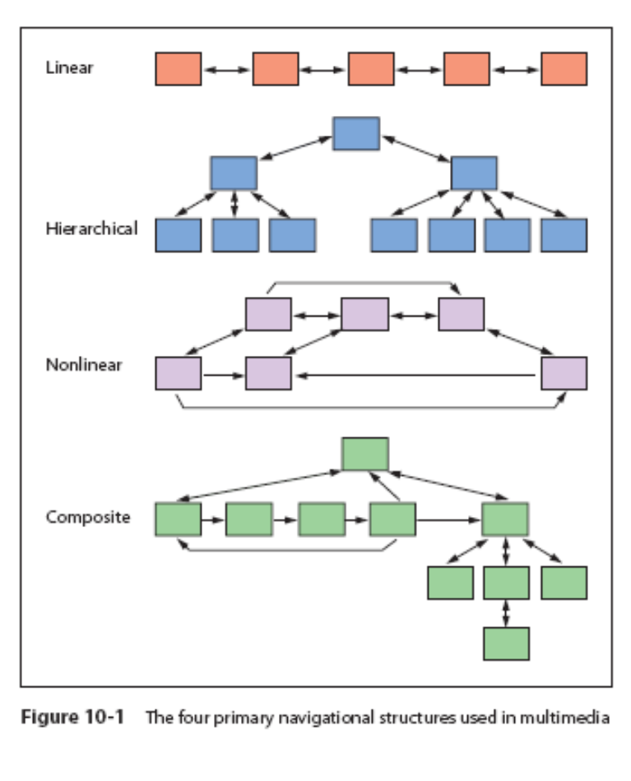
Designing the Structure

Slide 11
Designing the Structure
The navigation system should be designed in such a manner that viewers are given free choice.
The architectural drawings for a multimedia project are storyboards and navigation maps.
Storyboards are linked to navigation maps during the design process, and help to visualize the information architecture.

Slide 12
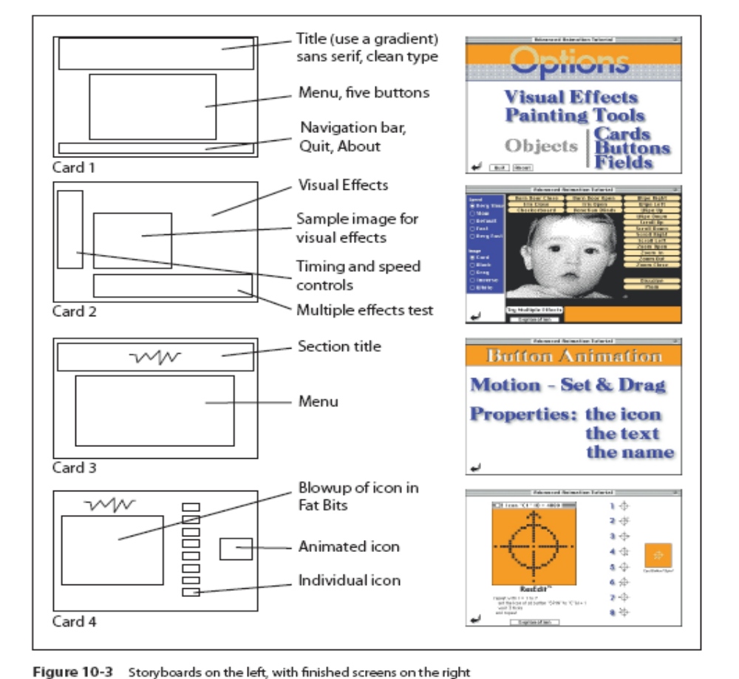

Slide 13
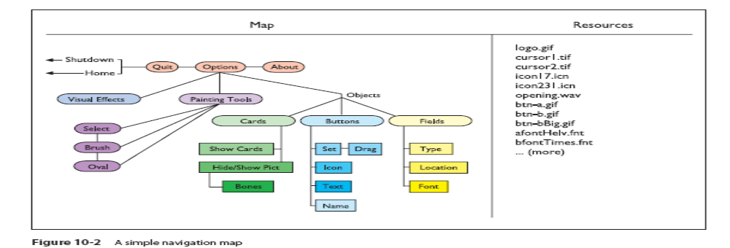
Designing the Structure
A user can design their product using two types of structures:
  Depth structure - Represents the complete navigation map and describes all the links between all the components of the project.
  Surface structure - Represents the structures actually realized by a user while navigating the depth structure.

Slide 14
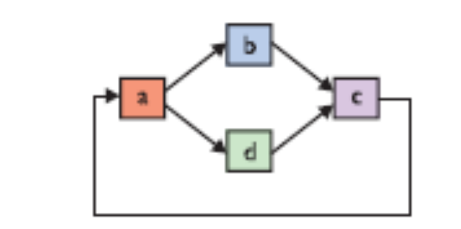
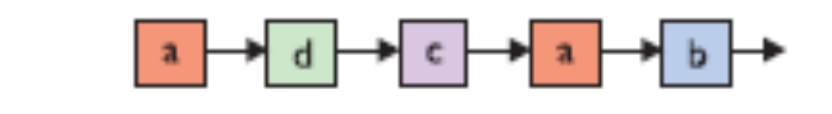
Designing the Structure
The following depth structure
Might be realized as the following surface structure

Slide 15
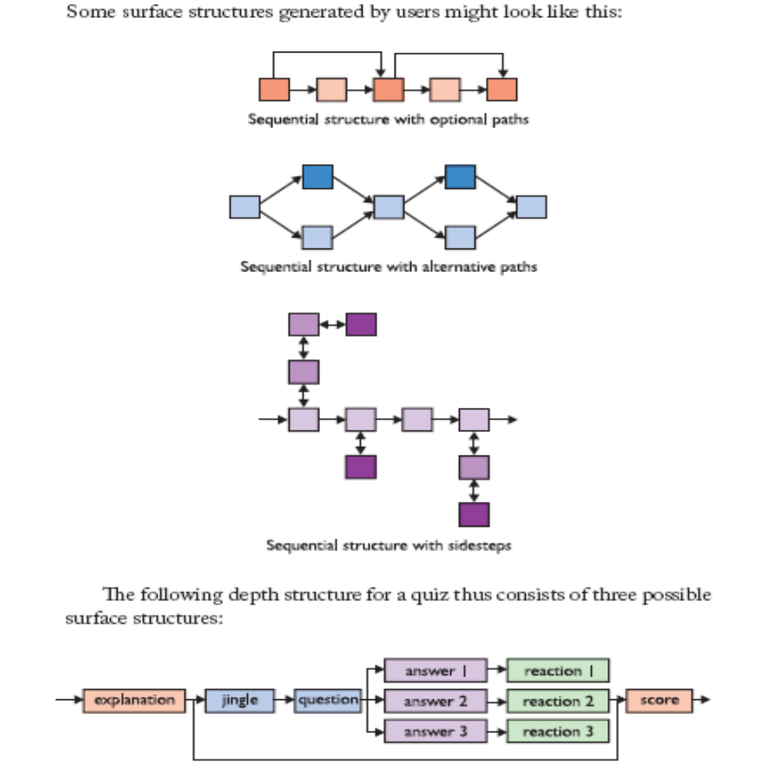

Slide 16
Designing the Structure
Hotspots:
  Add interactivity to a multimedia project.
  The three categories of hotspots are text, graphic, and icon.
  The simplest hot spots on the Web are the text anchors that link a document to other documents.

Slide 17
Designing the Structure
Hyperlinks - A hotspot that connects a viewer to another part of the same document, a different document, or another Web site is called a hyperlink.
Image maps - Larger images that are sectioned into hot areas with associated links are called image maps.

Slide 18
Designing the Structure
Icons - Icons are fundamental graphic objects symbolic of an activity or concept.
Buttons - A graphic image that is a hotspot is called a button.

Slide 19
Designing the Structure
Plug-ins such as Flash, Shockwave, or JavaScripts enable users to create plain or animated buttons.
Small JPEG or GIF images that are themselves anchor links can also serve as buttons on the Web.
Highlighting a button is the most common method of distinguishing it.

Slide 20
Designing the Structure
It is essential to follow accepted conventions for button design and grouping, visual and audio feedback, and navigation structure.
Avoid hidden commands and unusual keystroke/mouse click combinations.

Slide 21
Designing the User Interface
The user interface of a project is a blend of its graphic elements and its navigation system.
The simplest solution for handling varied levels of user expertise is to provide a modal interface.
In a modal interface, the viewer can simply click a Novice/Expert button and change the approach of the whole interface.

Slide 22
Designing the User Interface
Modal interfaces are not suitable for multimedia projects.
The solution is to build a project that can contain plenty of navigational power, which provides access to content and tasks for users at all levels.
The interface should be simple and user-friendly.

Slide 23
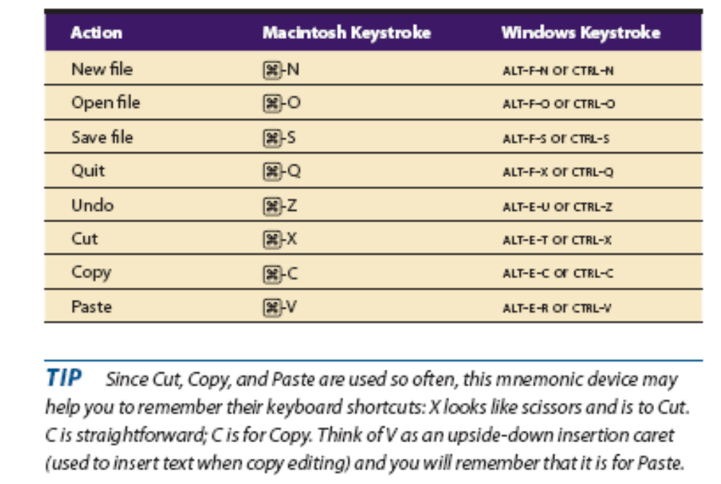
Designing the User Interface
Graphical user interface (GUI):
  The GUIs of Macintosh and Windows are successful due to their simplicity, consistency, and ease of use.
  GUIs offer built-in help systems, and provide standard patterns of activity that produce the standard expected results.

Slide 24
Designing the User Interface
Graphical approaches that work:
  Plenty of "non-information areas," or white space in the screens.
  Neatly executed contrasts.
  Gradients.
  Shadows.
  Eye-grabbers.

Slide 25
Designing the User Interface
Graphical approaches to avoid:
  Clashes of color.
  Busy screens.
  Requiring more than two button clicks to quit.
  Too many numbers and words.
  Too many substantive elements presented too quickly.

Slide 26
Designing the User Interface
Audio interface:
  A multimedia user interface can include sound elements.
  Sounds can be background music, special effects for button clicks, voice-overs, effects synced to animation.
  Always provide a toggle switch to disable sound.

Slide 27
Producing a Multimedia Project
In the development or the production phase, the project plan becomes the systematic instruction manual for building the project.
The production stage requires good organization and detailed management oversight during the entire construction process.

Slide 28
Producing a Multimedia Project
A good time-accounting system for everyone working on a project is required to keep track of the time spent on individual tasks.
It is important to check the development hardware and software and review the organizational and administrative setup.

Slide 29
Producing a Multimedia Project
Potential problems can be avoided by answering these questions:
  Is there sufficient disk storage space for all files?
    Is the expertise available for all stages of the project?
    Is there a system for backing up critical files?
    Are the financial arrangements secure?
    Are the communications pathways open with clients?

Slide 30
Producing a Multimedia Project
Working with clients:
  Have a system in place for good communication between the client and the people actually building the project.
  Control the client review process to avoid endless feedback loops.

Slide 31
Producing a Multimedia Project
Working with clients (continued):
  Develop a scheme that specifies the number and duration of client approval cycles.
  Provide a mechanism for change orders when changes are requested after sign-off.

Slide 32
Producing a Multimedia Project
Data storage media and transportation:
  This is necessary so that a client is easily able to review the work.
  There needs to be a matching data transfer system and media.
  Access to the Internet at high bandwidth is preferred.
  The most cost-effective and time-saving methods of transportation are CD-R or DVD-ROMs.

Slide 33
Producing a Multimedia Project
Tracking:
  Organize a method for tracking the receipt of material to be incorporated in a project.
  Develop a file-naming convention specific to your project's structure.

Slide 34
Producing a Multimedia Project
Tracking (continued):
  Store the files in directories or folders with logical names.
  To address cross-platform issues, develop a file identification system that uses the DOS file-naming convention of eight characters plus a three-character extension.

Slide 35
Summary
Feedback loops and good communication between the design and the production efforts are critical to the success of a project.
The four fundamental organizing structures are linear, non-linear, hierarchical, and composite.
The user interface should be simple, user-friendly, and easy to navigate.

Slide 36
Summary
The three categories of hotspots are text, graphic, and icon.
A multimedia project is actually rendered in the production stage.

